Slide 1

Project name: Smart Pest Repeller
Team members: Andrew Albritton Michael McNeil
Melquisedec Ordonez

Slide 2
Executive Summary
Problem Statement:
Pest control is a issue that often makes people choose between environmentally harmful solutions or solutions that are not very effective.
Pest control models that do not use harmful chemicals or pesticides, often are ineffective due to the limited range of frequencies they can generate (different pests respond to different frequencies)
Solution Proposal:
Our device will utilize an image based ML model in order to classify between three different subgroups of organisms in order to allow for repelling flies, rodents, and lizards.
Once one of the listed organisms is recognized the sound system will emit the corresponding frequency of the recognized organism.

Slide 3
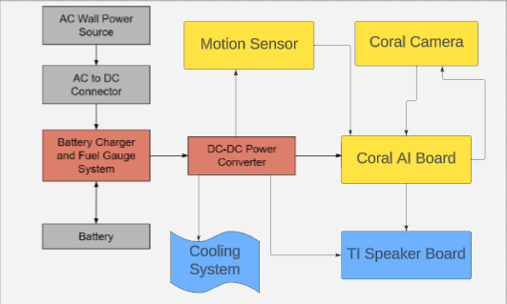
Diagram of subsystems and interface
Red / Grey: Michael McNeil
Yellow: Andrew Albritton
Blue: Melquisedec Ordonez

Slide 4
Task Partition
Andrew: ML image classification, camera operations and motion sensor
Michael: Power supply and battery system
Melquisedec: Ultrasonic emitter and cooling system

Slide 5
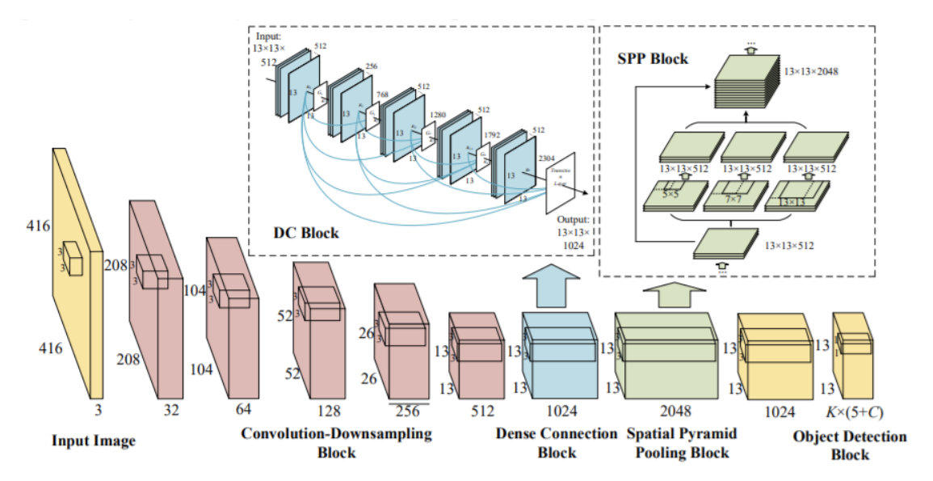
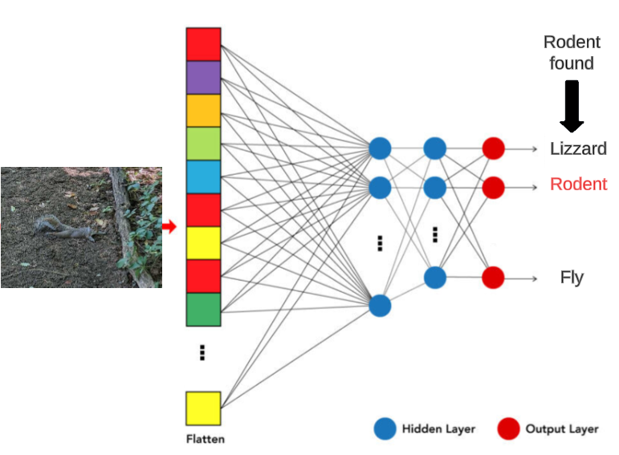
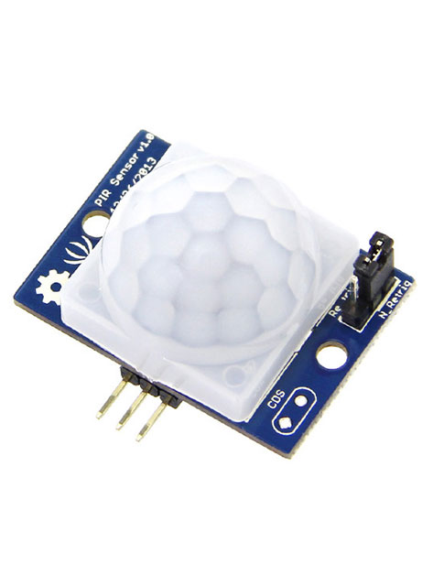
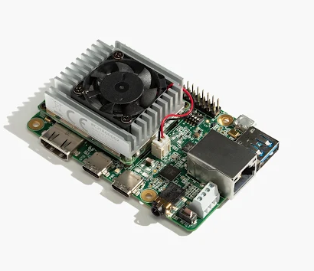
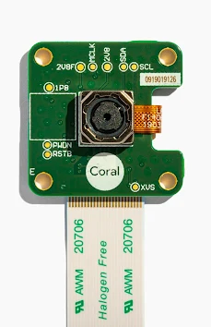
Machine Learning Image Recognition -
A motion sensor when triggered will activate a camera attached to the Coral board.
This image will result in one of the four following labels: Rodent, Lizard, Fly, or ignore.
The ignore label will prevent the speakers from activating when the motion sensor is triggered by a person, dog, bird, etc.
We will be using the YOLO git repository to create and test our model. A figure of YOLO’s algorithm can be found in the top right hand corner

Slide 6
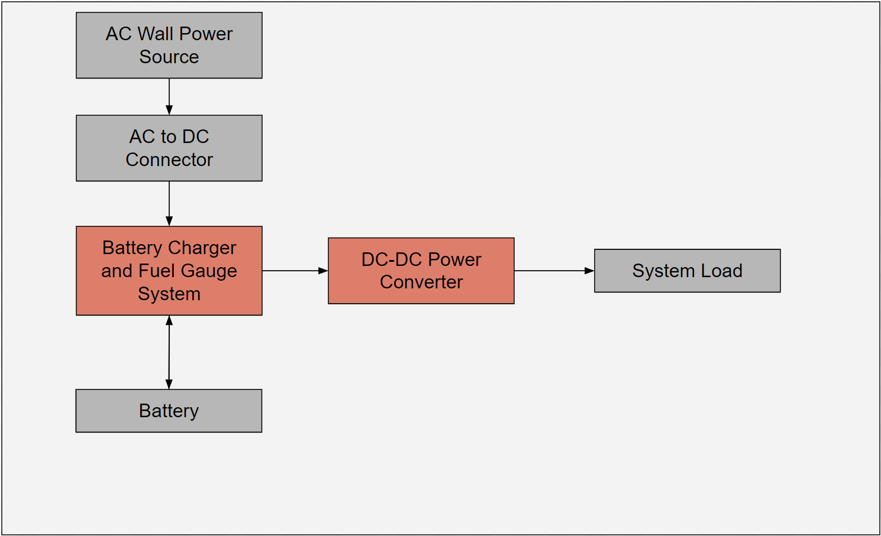
Power System
Wall Power Mode:
System, when connected to wall power, will power the main microcontrollers while charging the battery
Battery charging circuit will monitor fuel level of battery in order to prevent overvoltage and potential damage to the battery
Battery Mode:
System, when disconnected from wall power, will operate via battery power
System will include a fuel gauge to indicate to user when it is time to charge the system again.

Slide 7
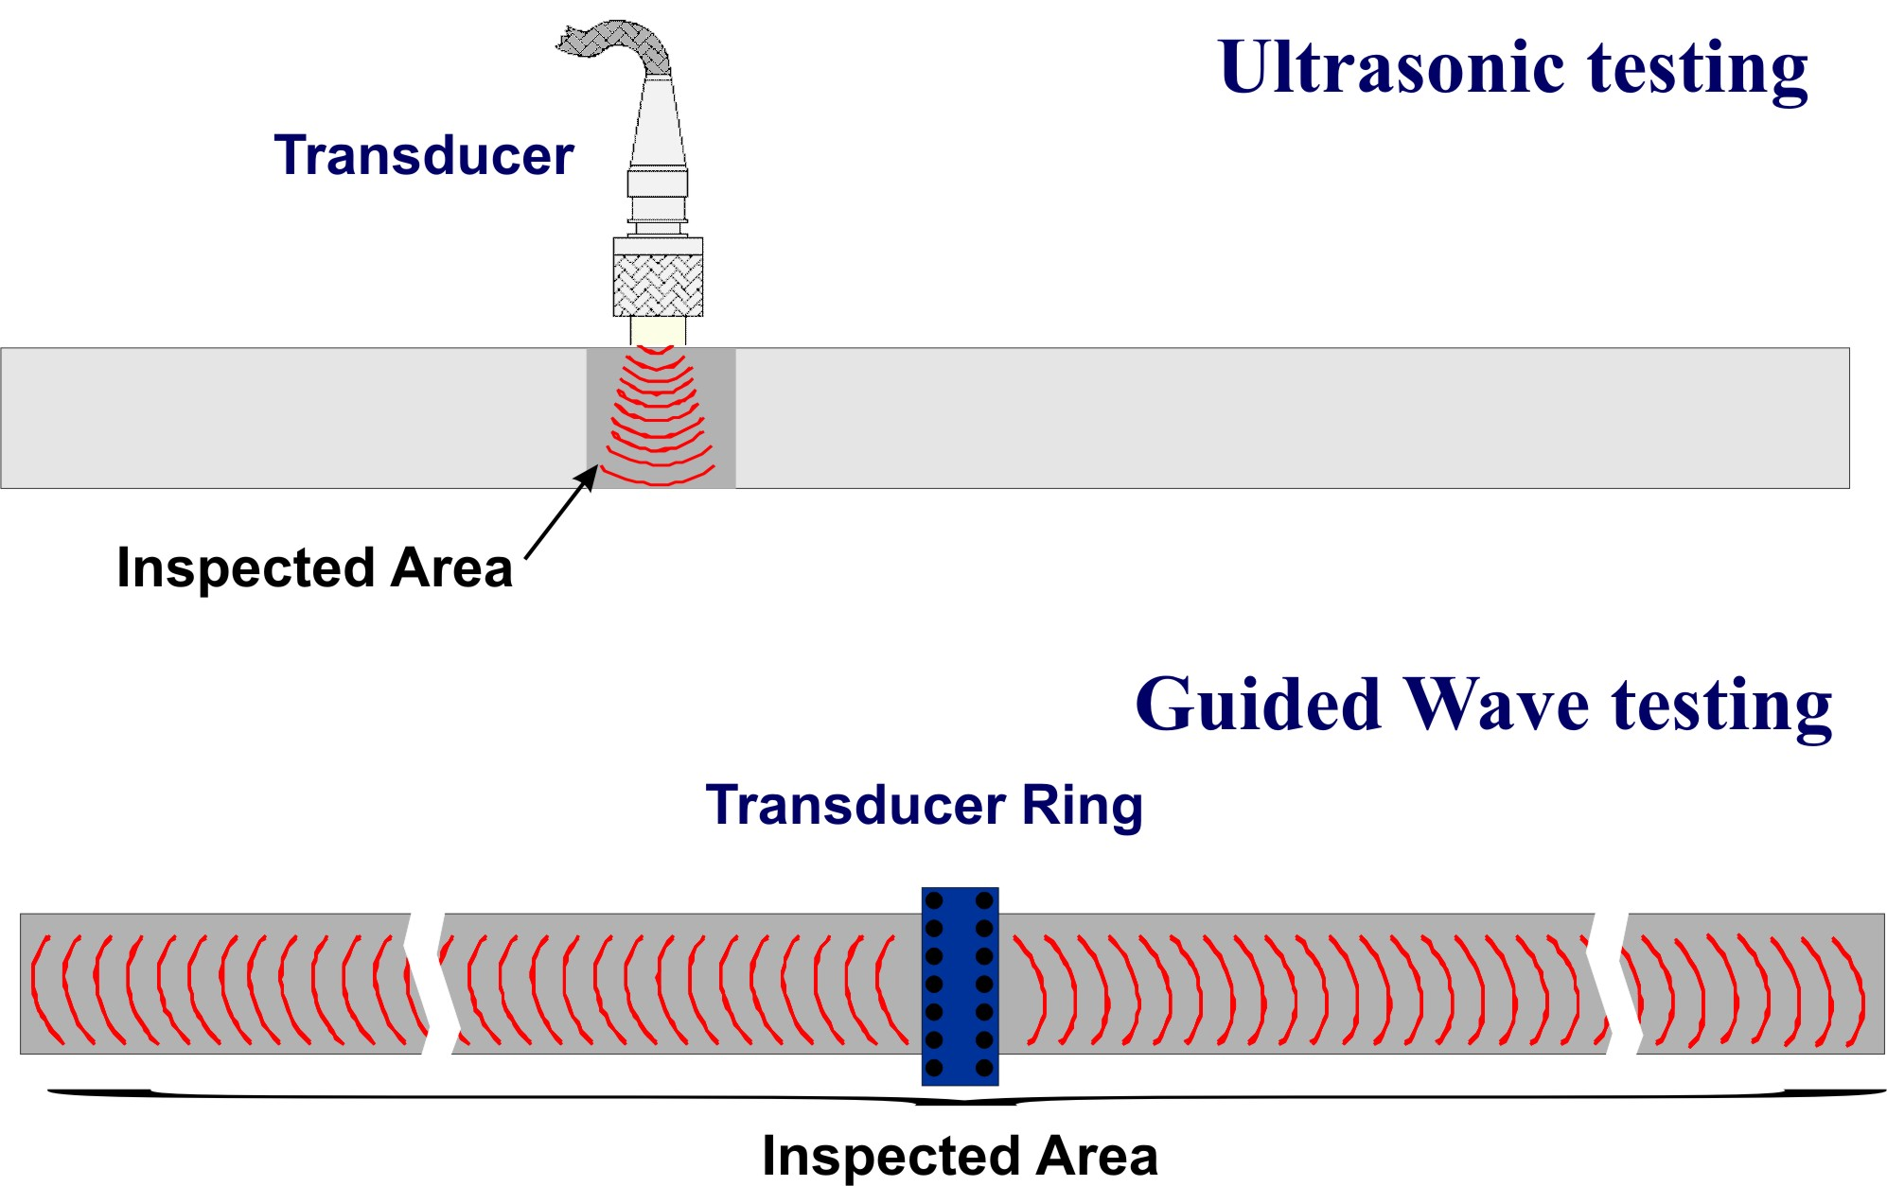
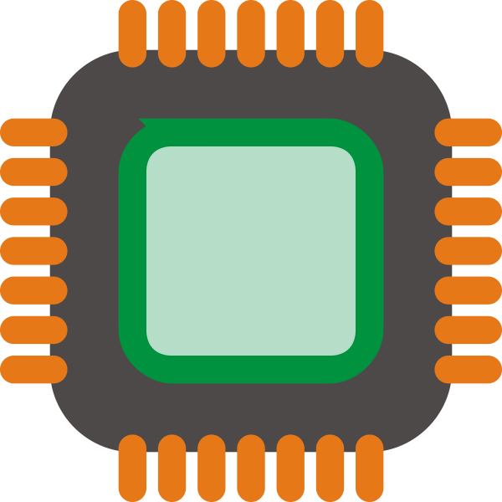
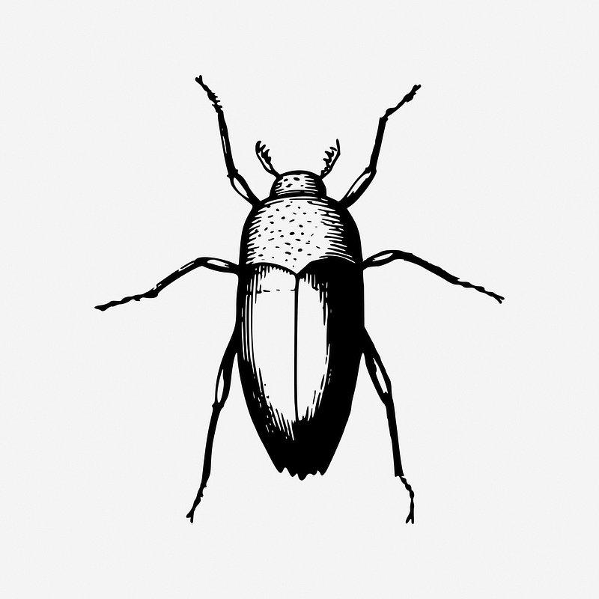

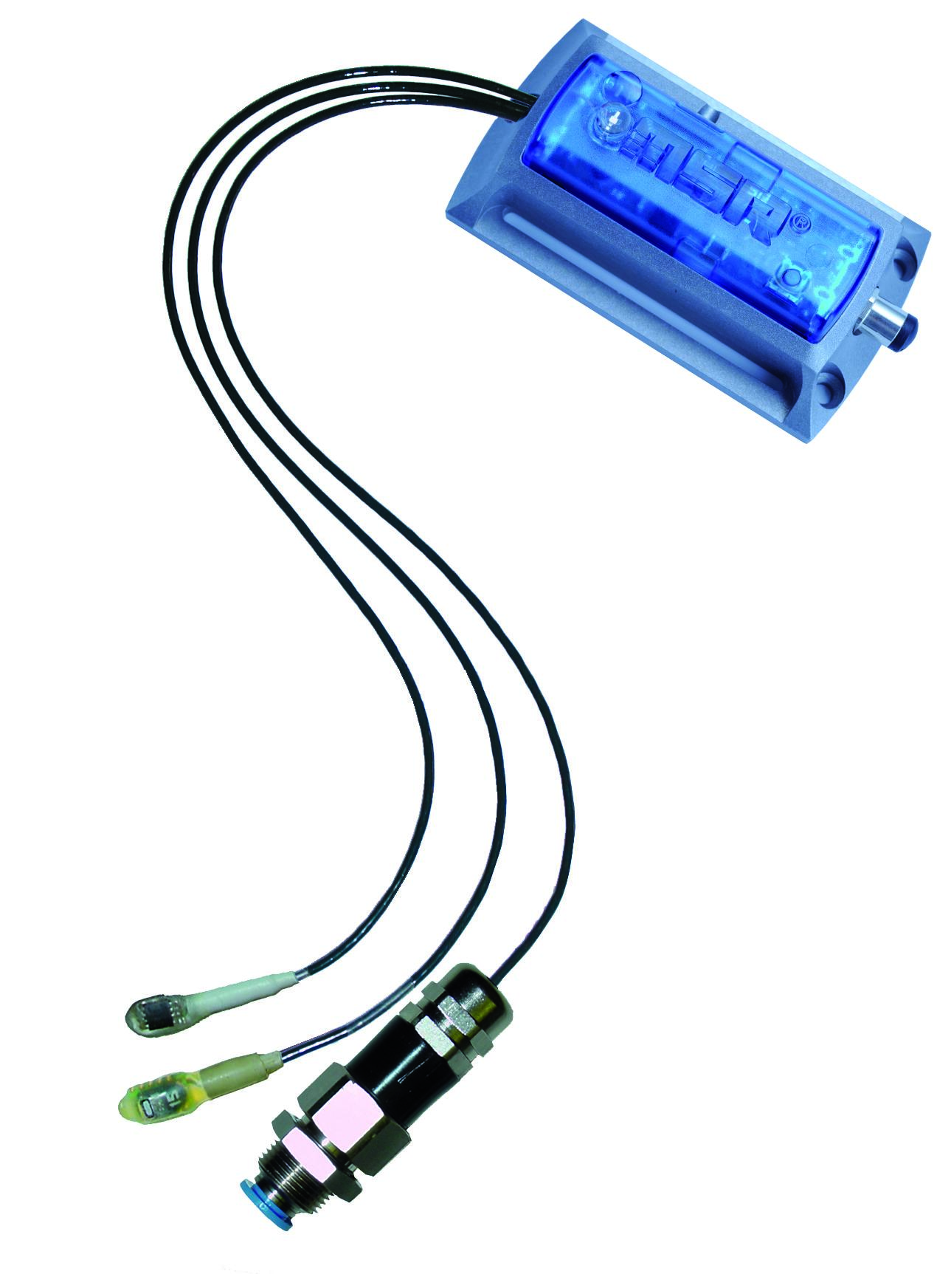
Sound/Cooling System
Transmitter emmitts ultrasonic sound sensitive to the particular pest detected by camera, eg insect or rodent.
Humidity sensor detects when humidity levels are beyond operating range of devices
Fan keeps system units dry to keep them operational on hotter or wet conditions.

Slide 8
Execution and Validation plan
Currently: have outlined needs for each system, assembled partial parts list, begun preliminary subsystem designs
 | October 14th | October 28th | November 14th | November 25th
Machine Learning Image Model, Camera, and Motion sensor | -Finish putting together YOLO training algorithm -Start working on training | -Finish Training, and test for a goal of >=90% precision -Begin model implementation on Coral Board | -Finish Camera program .py configuration -Install Motion sensor, and test camera -Ensure proper program speed | -Finish testing the built model using the camera and motion sensor
Power Delivery / Management | -Finalize PCB Design -Run simulations -Order Parts | -Learn to solder -Start to assemble PCB circuitry | -Finish PCB implementation -Start testing and debug | -Finish test and debug -Validate system
Sound/Cooling System | - Final system parts delivered -System design completed | -Validate/Stress test individual components | -Begin on integration of individual parts | -Stress test integrated parts

Slide 9
Questions?

